Slide 1


Focus Web Developer
Week 2 – Lesson 1
Notes:
Welcome your class, think about what is the hook to engage your students right out of the starting gate.

Slide 2
Lesson Topics
Review
HTML 5 Practice Activities
Notes:
Pre-test
Two-way learning

Slide 3
Review
HTML (structure)
CSS (style)
JS (functionality)
It can run a program/script in the background
It can change HTML and CSS to create a “dynamic” webpage

Slide 4
What’s next?
To effectively make JavaScript programs, you need to have a strong command of HTML and CSS
More practice on HTML and CSS

Slide 5
What’s next
Try to stay organized throughout the course so you can reference your materials later if you need to. Here are some recommendations:
Create a new folder for every week with subfolders for every day and activity
Ex: the next activity will be located in Week 2 → Day 1 → Activity 1
Make a bookmarks folder to keep any useful websites for later use and name them so you know what they are!
In general, more folders = more organized = easier to find things

Slide 6
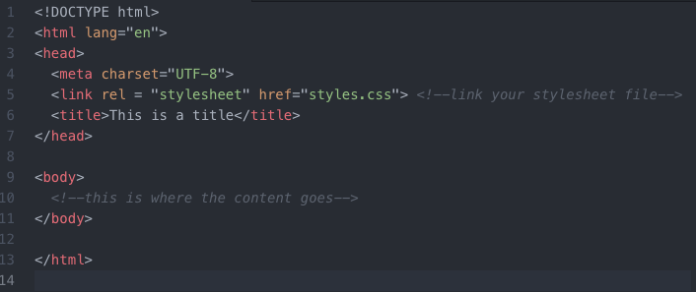
HTML Boiler Plate
No matter what website you are making this information will always be present!

Slide 7

Activity 1 Introduction
Create the following webpage using only HTML
This image is a hyperlink that opens in the same tab with some alternate text
Activity 1 is from https://www.delidded.com/html-css-practice-test/

Slide 8
Activity 1 Introduction
In addition to the <tags> in your boilerplate, here are some of the <tags> to create this webpage:
<a> - Defines a hyperlink
<h1> - Defines HTML heading <h1> is the biggest <h6> is the smallest
<p> - Defines a paragraph
<h2> - Defines HTML heading <h1> is the biggest <h6> is the smallest
<ul> - Defines an unordered list
<li> - Defines a list item
Note: this page has no <header> or <footer> tags
For a full list of HTML <tags> aka ”elements” go here:
https://www.w3schools.com/TAGs/

Slide 9
HTML <tags> aka elements
Things to remember about HTML <tags> aka “elements”
HTML elements have properties that determine what can be done with it
All HTML elements have different attributes that you can change
Attributes provide additional information about elements
Attributes are always specified in the start tag
Attributes usually come in name/value pairs like: name="value"

Slide 10
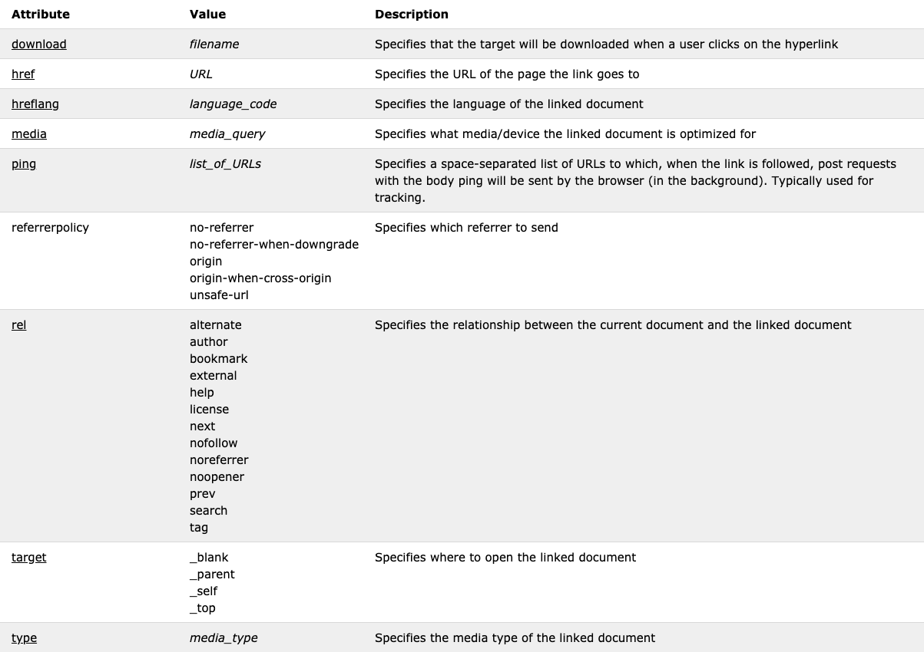
HTML Element Attributes
Here are the attributes of <a>:
this is the name of the attribute
These are the possible values for this attribute
How to use this attribute:
<a target=“_blank”></a>
Image from https://www.w3schools.com/TAGs/tag_a.asp
Notes:
Explain how to use these.
You can reference any element’s attributes this way

Slide 11
Activity 1 Instructions
Create the following webpage using only HTML
Requirements:
Use only HTML to make identical format
Save the file in your Activity 1 folder and name it “index.html”
Use <title>Activity 1</title> in the head
Image hyperlinked to https://www.delidded.com in the same tab
Image alternate text: “Delidded Logo”
Image from https://www.delidded.com/logo.png
Hints:
Some HTML <tags> to be used are: <a>, <h1>, <p>, <h2>, <ul>, <li>
Solution:
you can find the full solution on the next page. Please DO NOT check this site until you have completely done this on your own
Activity 1 is from https://www.delidded.com/html-css-practice-test/

Slide 12
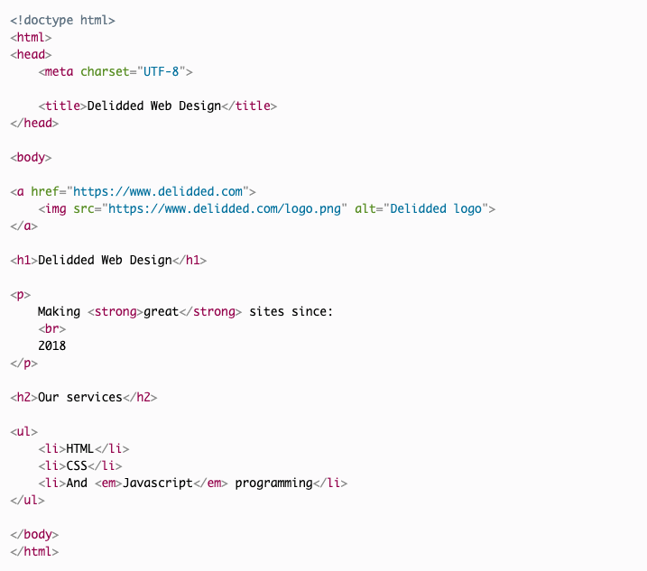
Activity 1 Solution
Activity 1 is from https://www.delidded.com/html-css-practice-test/

Slide 13
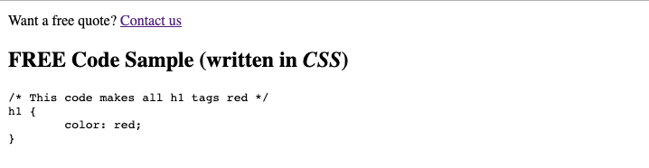
Activity 2 Introduction
Create the following webpage using only HTML
Hyperlink to that opens in a new tab
Normally this code would change the color of the <h1> tags, but here it doesn’t…why?
Activity 2 is from https://www.delidded.com/html-css-practice-test/

Slide 14
Activity 2 Introduction
In addition to the <tags> in your boilerplate, here are some of the <tags> to create this webpage:
<a> - Defines a hyperlink
<h2> - Defines HTML heading <h1> is the biggest <h6> is the smallest
<pre> - Defines preformatted text
Note: this page has no <header> or <footer> tags
For a full list of HTML <tags> aka ”elements” go here:
https://www.w3schools.com/TAGs/

Slide 15
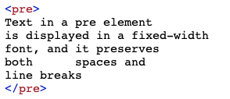

HTML <pre> element
The <pre> element “defines preformatted text”
The text will be displayed exactly as written in the HTML source code
HTML Code
What you see in the web browser

Slide 16
Activity 2 Instructions
Create the following webpage using only HTML
Requirements:
Use only HTML to make identical format
Save the file in your Activity 2 folder and name it “index.html”
Use <title>Activity 2</title> in the head
Contact Us hyperlink in a new tab to:
https://www.delidded.com/html-css-practice-test/
Hints:
Some of the HTML <tags> to be used are: <a>, <h2>, <pre>
Solution:
you can find the full solution on the next page. Please DO NOT check this site until you have completely done this on your own
Activity 2 is from https://www.delidded.com/html-css-practice-test/

Slide 17
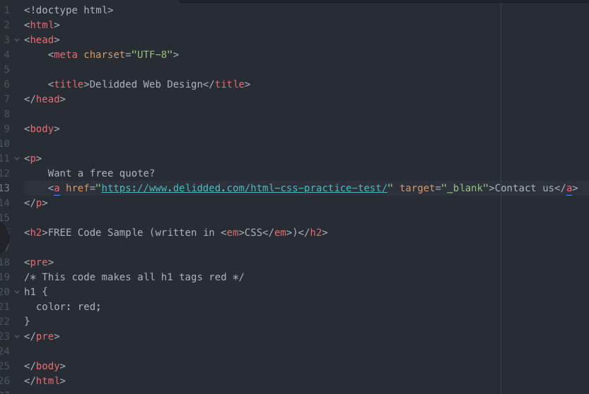
Activity 2 Solution
Activity 2 is from https://www.delidded.com/html-css-practice-test/

Slide 18
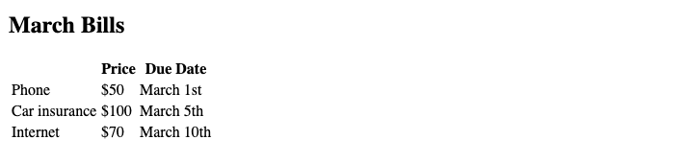
Activity 3 Introduction
Create the following webpage using only HTML
This is a table
Activity 3 is from https://www.delidded.com/html-css-practice-test/

Slide 19
Activity 2 Introduction
In addition to the <tags> in your boilerplate, here are some of the <tags> to create this webpage:
<h2> - Defines HTML heading <h1> is the biggest <h6> is the smallest
<table> - Defines a table
<tr> - Defines a row in a table
<th> - Defines a header cell in a table
<td> - Defines a cell in a table
Note: this page has no <header> or <footer> tags
For a full list of HTML <tags> aka ”elements” go here:
https://www.w3schools.com/TAGs/

Slide 20
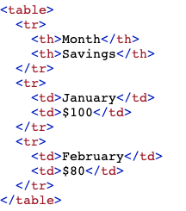

HTML <table> element
The <table> is used to create a table and is often used with <tr>, <th>, <td>
HTML Code
What you see in the web browser
How do you enter data into the table? Horizontally or vertically?
Notes:
You enter data in horizontally. You go row by row to enter data. Walk through the code with the students.

Slide 21
Activity 3 Instructions
Create the following webpage using only HTML
Requirements:
Use only HTML to make identical format
Save the file in your Activity 3 folder and name it “index.html”
Use <title>Activity 3</title> in the head
Hints:
Some HTML <tags> to be used are: <h2>, <table>, <tr>, <th>, <td>
Solution:
you can find the full solution in the following pages. Please DO NOT check this site until you have completely done this on your own
Activity 3 is from https://www.delidded.com/html-css-practice-test/

Slide 22
Activity 3 Challenge Instructions
If you want more of a challenge for Activity 3 try the following (use the same HTML file, but make a CSS file named styles.css and link it to your HTML)
Challenges:
Using only your CSS file do the following:
make the font in the table headers blue
make the font in the first row red
make the font in the second row green
make the font in the third row orange
make ”March 5th” italics
put a solid black border of 1px around the outside of the table only
Put a dotted green border around the cells containing Price and Due Date
Put a dotted red border around all other cells
Color the background of the “Internet” cell pink
Activity 3 is from https://www.delidded.com/html-css-practice-test/

Slide 23
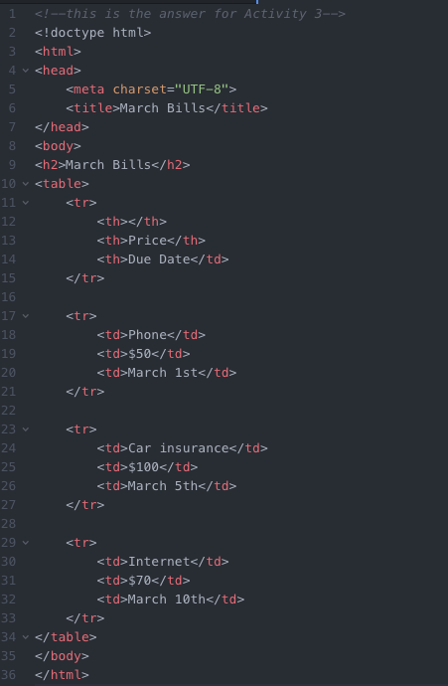
Activity 3 Solution
Activity 2 is from https://www.delidded.com/html-css-practice-test/

Slide 24
Activity 4
Imagine you have to make a portfolio website to “advertise” yourself.
Make a sketch showing roughly what the format of the website will look like. Be sure to include the following:
Header
Footer
Body
Links (in a navigation bar or just hyperlinks) to different pages such as contact, about me, my work
Respond in Slack with a picture of your sketch!

Slide 25
Gathering Time
Gathering Time is a time for check-in.
Notes:
Instructors Notes:
Introduce the concept of Gathering Time, which will be used throughout the program.
The sharing stone can be just a stone someone in the class wants to use or one from outside.
It just reminds everyone to listen when the person with the stone talks, so everyone has an opportunity to listen.
Chairs only
Someone from the host Nation can be offered to start the check-in first. If no one is interested then someone else in the group, or the Instructor, will be offered to start it next.

Slide 26
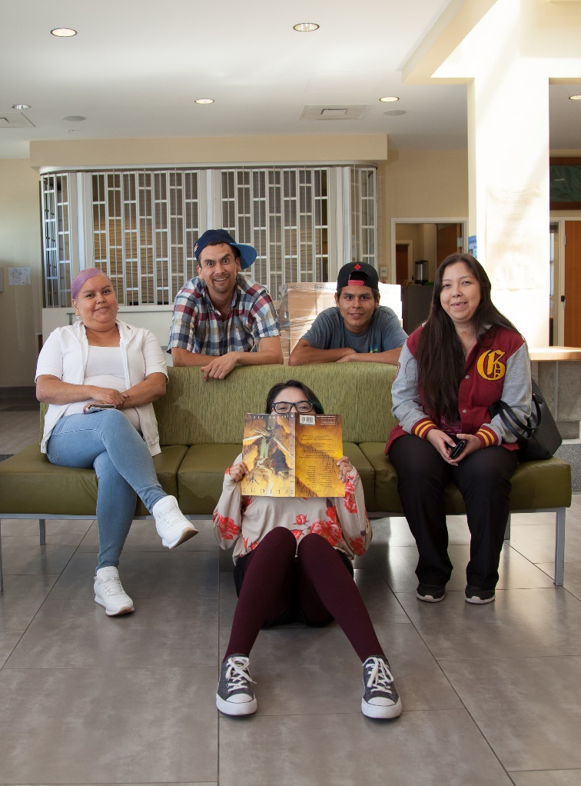
Class Wrap-up
How was your day?
How’s your website coming along?
Are you excited to add some colour?
Notes:
Post test: provide the students with feedback about the day, review the day.
End of the day Q/A
Were the day’s goals met (reference slide 2)?
Transition: what’s coming up tomorrow?

Slide 27
Image Credits
Unless specified, all images in this slide show are from the following sources
Unsplash via the Unsplash License
Pexels and Pixabay via the CC0 License or the Pexels License
Wikimedia Commons
First Nations Technology Council and its partners
Pow wow https://www.cbc.ca/kidscbc2/the-feed/do-you-know-what-a-powwow-is
Colors http://precisionintermedia.com/color
Fonts https://furbo.org/2018/03/28/system-fonts-in-css/

